Slide 1
MedExplain – Explainable Machine Learning Framework for Clinical Diagnosis Prediction
Saraf Abhinav – 2420090058
Jai Vardhan – 2420090104
Srimaan – 2420030418
Ananya - 2420030776

Slide 2
Methodology
Data Collection: Used three benchmark medical datasets covering cardiovascular, metabolic, and oncology diseases.
Preprocessing: Applied MICE imputation, outlier capping, robust scaling, and duplicate handling.
Class Balancing: SMOTE-Tomek was applied only within training folds to reduce class imbalance.
Model Development: Trained Logistic Regression, Decision Tree, Random Forest, XGBoost, and CatBoost models.
Evaluation: Used stratified 5-fold cross-validation with Accuracy, Precision, Recall, F1-score, and ROC-AUC.
Explainability: Applied SHAP for global and local feature importance and LIME for patient-level explanations.
Deployment: Integrated the best-performing models into an interactive Streamlit clinical decision-support dashboard.

Slide 3
System Design
System Design
Input Layer
Patient demographic and clinical information
Disease-specific medical parameters
↓
Data Processing Layer
Missing-value handling
Outlier treatment
Feature scaling
Class balancing
↓
Machine Learning Layer
Logistic Regression
Decision Tree
Random Forest
XGBoost
CatBoost

Slide 4
↓
Prediction Layer
Disease-risk classification
Confidence/probability score
↓
Explainability Layer
SHAP global feature importance
SHAP local explanations
LIME patient-level explanations
↓
User Interface
Streamlit-based clinical dashboard
Patient input
Prediction results
Visual explanations
Model comparison

Slide 5
Modern Tools and Technologies
Technology | Purpose
Python | Core development and machine learning
Pandas & NumPy | Data processing and numerical operations
Scikit-learn | ML models, preprocessing and evaluation
XGBoost | Gradient-boosting classification
CatBoost | Advanced gradient-boosting classification
SHAP | Global and local model explanations
LIME | Patient-level local explanations
Imbalanced-learn | SMOTE-Tomek class balancing
Streamlit | Interactive clinical dashboard
Matplotlib / Visualization Tools | Charts and performance visualization

Slide 6
Implementation
Step 1 — Dataset Preparation
Cleveland Heart Disease
Pima Indians Diabetes
Wisconsin Breast Cancer Diagnostic
Step 2 — Data Preprocessing
Missing-value imputation
Outlier capping
Robust feature scaling
Training-fold class balancing
Step 3 — Model Training
Five classification algorithms trained independently.
Stratified 5-fold cross-validation used for reliable evaluation.

Slide 7
Step 4 — Explainability
SHAP identifies important features influencing predictions.
LIME provides individual patient-level explanations.
Step 5 — Dashboard Development
Patient data entered through Streamlit.
Model generates prediction and confidence.
SHAP and LIME visualizations explain the result.
Model performance can be compared through the dashboard

Slide 8
Results
Results
The framework achieved strong classification performance across all three medical domains.
Important Predictive Features
Heart Disease: Vessel count (ca), thallium status, ST depression, maximum heart rate
Diabetes: Plasma glucose, BMI, age
Breast Cancer: Concave points, perimeter, and radius — worst measurements
The results demonstrate that high predictive performance can be combined with interpretable explanations for clinical decision support.
Disease Domain | Best Model | ROC-AUC | Recall
Cardiovascular | CatBoost | 0.932 | 0.912
Metabolic / Diabetes | CatBoost | 0.884 | 0.846
Oncology / Breast Cancer | XGBoost | 0.991 | 0.982

Slide 9
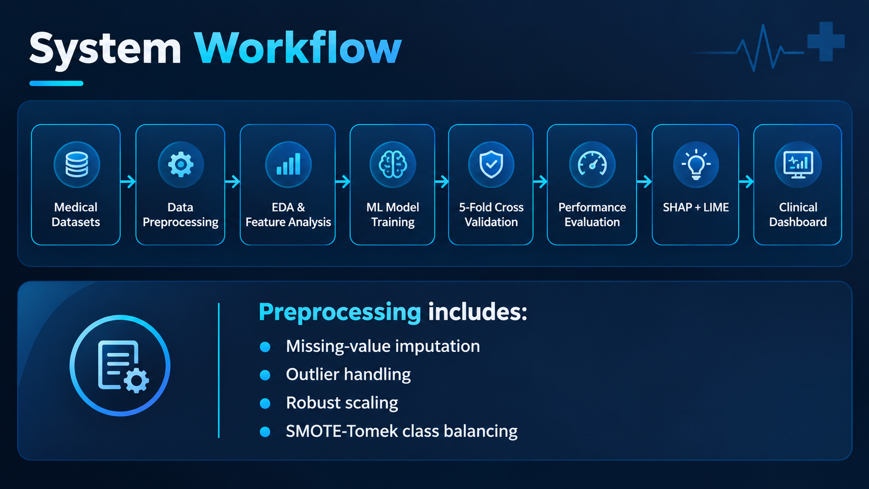

Slide 10
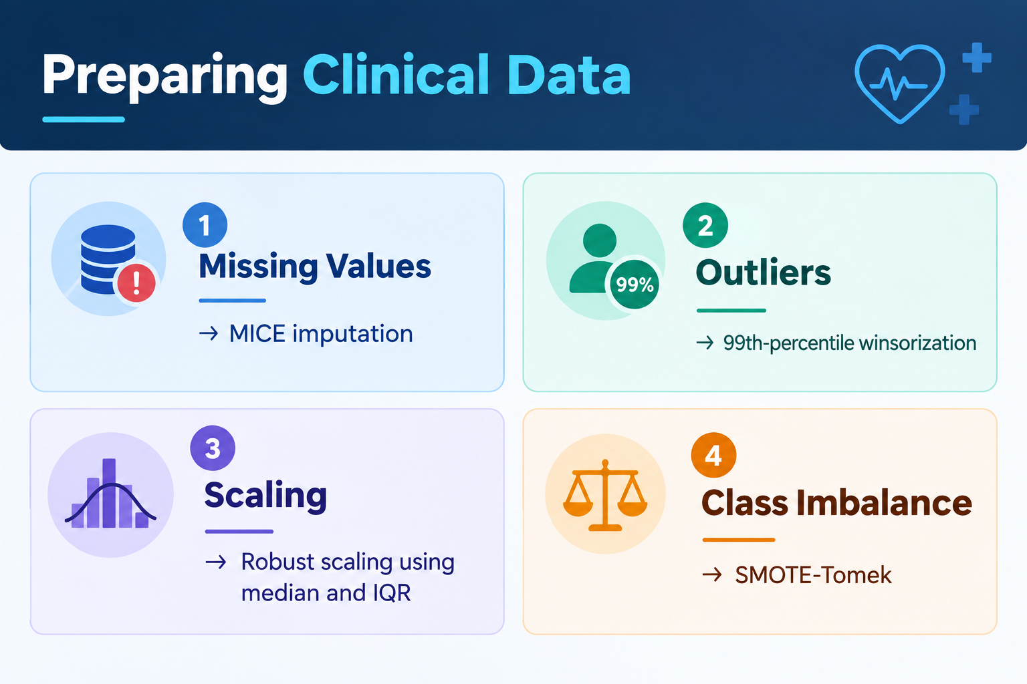

Slide 11
Performance Evaluation
Evaluation Strategy
Stratified 5-fold cross-validation
Accuracy
Precision
Recall / Sensitivity
F1-score
ROC-AUC
Calibration analysis
Statistical Analysis
Wilcoxon signed-rank tests were used to compare model performance across validation folds.

Slide 12
4. Methodology
Dataset description
Preprocessing
ML models
Evaluation methodology
SHAP and LIME framework
5. Results & Discussion
Model performance
Feature importance
SHAP and LIME explanations
Cross-domain comparison
6. Dashboard & Clinical Application
Streamlit implementation
Patient prediction
Explainable visualization

Slide 13
Conclusion & Future Work
Major findings
Limitations
Larger multicenter datasets
Causal and prospective clinical validation

